Slide 1
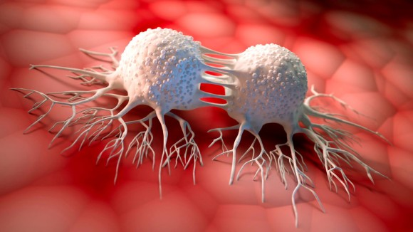
CELLULAR ADHESION
Dr. AOUATI Amel

Slide 2
Adhesion molecules and intercellular junctions
These are specialized areas located between adjacent cells or between cells and the extracellular matrix (ECM).
Role
Cohesion and adhesion
Intercellular communication
CAM (Cell Adhesion Molecules) Cell - Cell Interaction
SAM (Substrate Adhesion Molecules) Cell - Extracellular matrix (ECM)
Homophilic, there is an interaction between two identical proteins.
Heterophilic, there is an interaction between two different proteins.

Slide 3
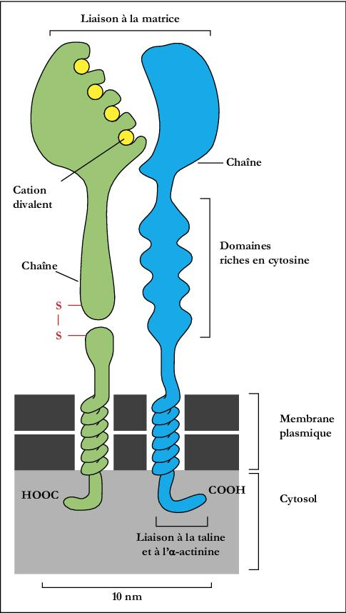
Integrins
These are heterodimeric proteins with two α and β chains. They are transmembrane proteins with a small cytoplasmic domain.
They are a family of membrane glycoproteins that act as cell surface receptors for components of the extracellular matrix (ECM).
They bind to several macromolecules: collagen, laminin, fibronectin, immunoglobulin, etc.
Integrins link cells to the extracellular matrix (fibronectin or laminin) or to receptors of the immunoglobulin family. These bindings can be regulated by the local concentration of divalent cations (Ca²⁺, Mg²⁺)
β
α
It allows cells to adhere to the matrix, but also intercellular adhesion.

Slide 4
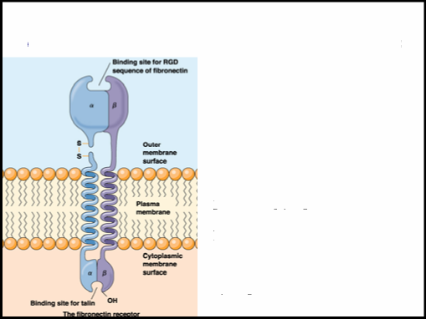
Binding specificity depends on the extracellular domain of the α subunits.
Extracellular binding domains identify the RGD (Arg-Gly-Asp) motif and other parts of glycoproteins.
The intracellular parts of integrins possess binding domains for cytoskeletal molecules.
Extracellular portion – binding site for the RGD sequence.
Intracellular portion – binding site for talin, a cytoskeletal protein indirectly linked to microfilaments.
By binding to extracellular molecules and intracellular microfilaments, integrin regulates the interaction between the cytoskeleton and the ECM.

Slide 5
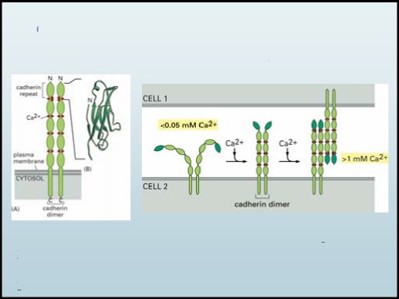
Cadherins
When Ca²⁺ binds to repeating cadherin domains, they can dimerize, changing conformation and binding to similar domains on an adjacent cell. Similarly, a decrease in extracellular Ca²⁺ can lead to cell dissociation.
Cadherin interactions are homophilic, with identical cadherins interacting to form cell tissues of the same type.
There are several types of cadherin:
E – epithelial and embryonic cells
P – placenta and epidermis
N – neurons and muscles
VE – vascular endothelial cells

Slide 6
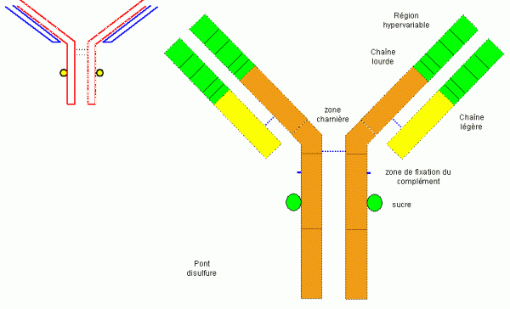
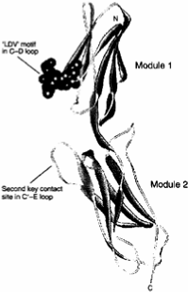
The Immunoglobulins superfamily (Igs)
Ig superfamily CAMs (Ig CAMs) : are calcium-independent transmembrane glycoproteins.
Many mediate interactions between lymphocytes and cells required for immune responses. “I-CAMs”
Some IgCAMs mediate adhesion between non-immune cells “V-CAMs, N-CAMs, L1”
Other IgCAMs mediate intercellular adhesion through binding to integrins. “I-CAMs”
The main cell adhesion molecules:
N-CAM (Neural CAM) Nerve cell adhesion molecule
V-CAM (Vascular CAM) Vascular cell adhesion molecule
I-CAM (Intercellular CAM) Intercellular adhesion molecule

Slide 7
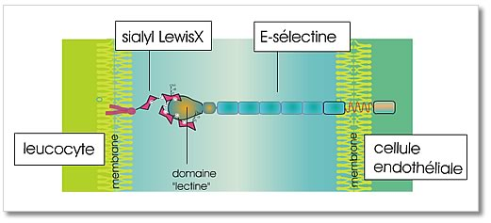
Selectins
These are transmembrane glycoproteins. Their ligands are sugar-based: glycoproteins and glycolipids.
They are Ca²⁺ dependent molecules.
There are 3 main types of selectins:
L-selectin: all circulating leukocytes
P-selectin: platelets and endothelial cells
E-selectin: activated endothelial cells

Slide 8
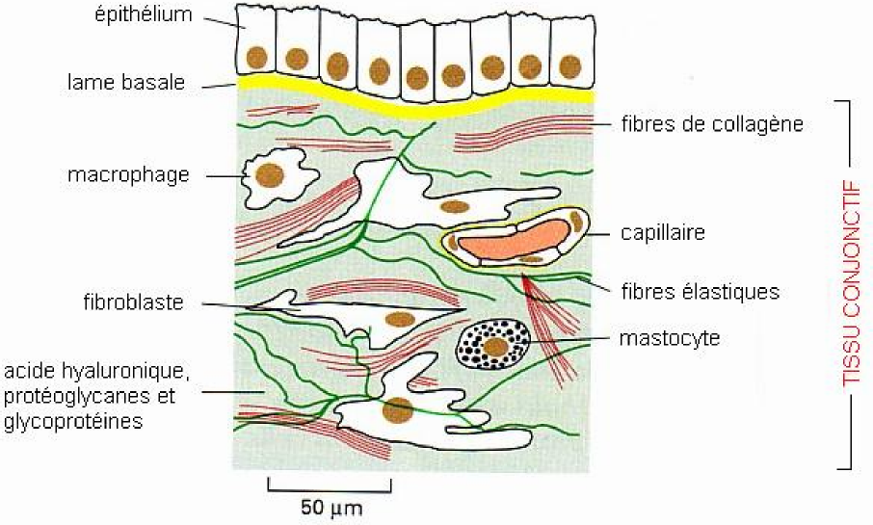
Extracellular matrix
Extracellular matrices are macromolecular frameworks (polysaccharides, fibrous proteins and glycoproteins) synthesized by characteristic cells depending on the tissue in question (fibroblasts, epithelial cells, osteoblasts, chondroblasts, etc.).

Slide 9
The components of the extracellular matrix
Polysaccharides:
- Glyco-amino-glycans (GAGs) - Proteoglycans
Fibrous proteins:
- Collagen fibers - Elastic fibers
Glycoproteins:
-Fibronectrin -Laminin

Slide 10
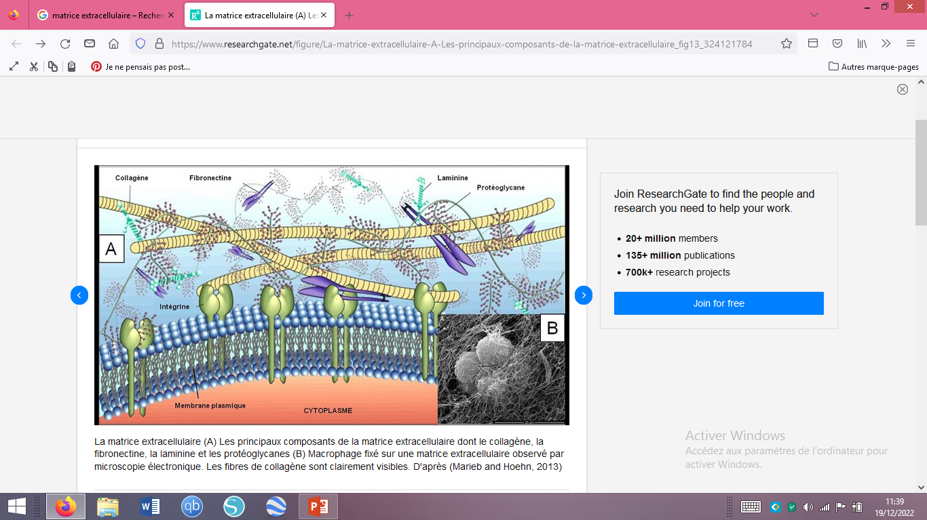
The extracellular matrix (A) The main components of the extracellular matrix including collagen, fibronectin, laminin and proteoglycans (B) Macrophage fixed on an extracellular matrix observed by electron microscopy. The collagen fibers are clearly visible. Based on (Marieb and Hoehn, 2013)

Slide 11
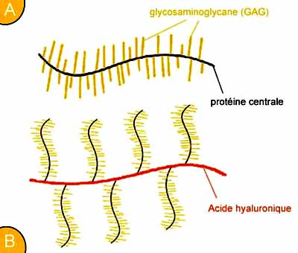
Proteoglycans
are formed by a protein core on which sulfated glycosaminoglycans bind.
Schematic representation of a single cartilage proteoglycan formed by a central protein to which chains of glycosaminoglycans (GAGs) such as heparan sulfate, keratan, dermatane, chondroitin are attached, etc.
(B) In the extracellular matrix, proteoglycans are united with a giant non-sulfated GAG, hyaluronic acid.

Slide 12
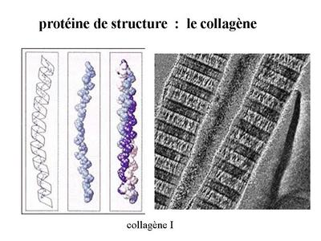
Fibrous proteins:
- Collagen fibers
Collagen 25% human protein mass Forms large fibers (500 nm in diameter and 1 to 10μm long) that are quite rigid, thanks to their particular AA compositions, which are very resistant to stretching. 1 amino acid out of 2 is a Glycine, a small aa that allows you to make angles (bends) that will stabilize the triple helix.

Slide 13
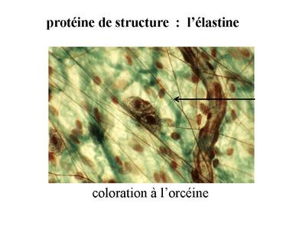
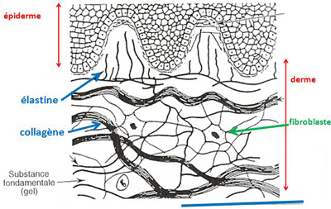
- Elastic fibers
Connective tissues that need elasticity (e.g. dermis, vessels, lungs, etc.). Collagen fibers are mixed with elastic fibers. The whole gives elasticity and prevents breakage.
Elastic fibers feature an elastin core, which is a fibrous protein resembling a polypeptide collagen chain, rich in Proline.

Slide 14
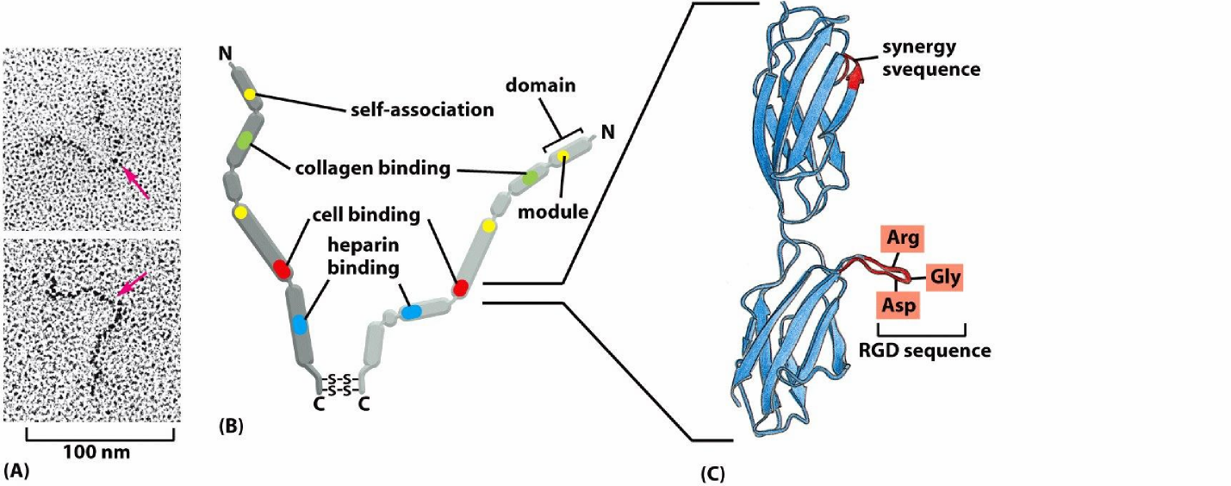
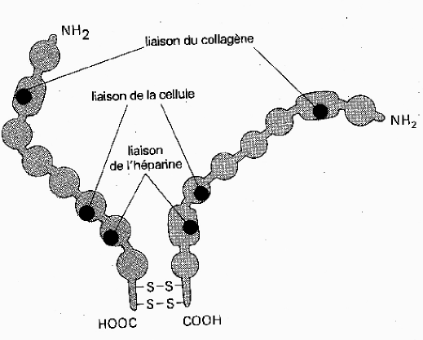
Glycoproteins
Fibronectin
It is a dimer of 2 subunits linked by a disulfide bridge, it is proteins with domains i.e. they have specific binding sites for different macromolecules.
It contains several membership sites:
To cells (RGD)
To other molecules of the extracellular matrix (collagen, heparin, fibrin, etc.)

Slide 15
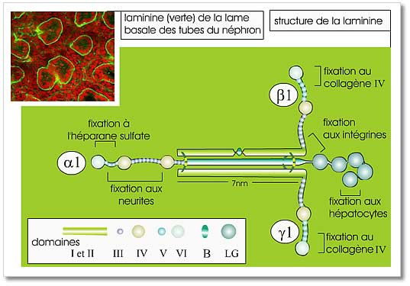
Laminine
Laminin is a large, flexible protein complex consisting of three polypeptide chains.
The three chains form an asymmetric cross with several sites of interaction with cells (via integrins) and with the other components of the extracellular matrix (type IV collagen and heparan sulfate).
Laminin is the essential constituent of the basal laminae.

Slide 16
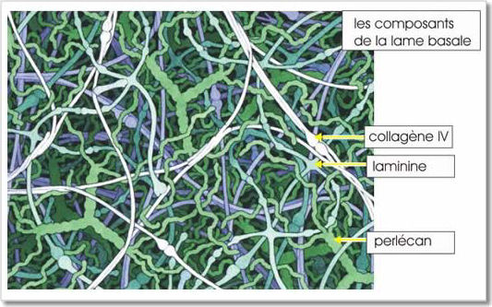
BASAL BLADES
In some tissues, the extracellular matrix forms a thin, compact and resistant layer "the basal lamina".
It is found at the base of all epithelial and endothelial sheets, it surrounds muscle cells, fat cells, Schwann cells (which form the myelin sheath surrounding the axons of peripheral nerve cells).
The basal lamina serves as a molecular filter.
The basal lamina is produced by the cells that then lean on it.
It consists of type IV collagen, laminin and proteoglycans It is involved in glomerular filtration.

Slide 17
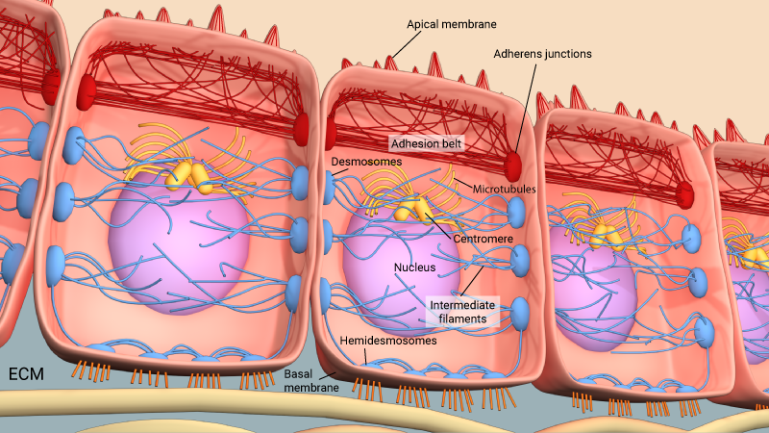
CELL JUNCTIONS
Although a hundred individual cell-cell adhesions is sufficient for cells to adhere, specialized junctions containing the dense aggregates of adhesion molecules are required for tissue function.
There are five common types in animal cells:
Tight/Tight Junction Adhesive / anchor junction Les Desmosomes Gap/communicating junction Hemidesmosomes

Slide 18
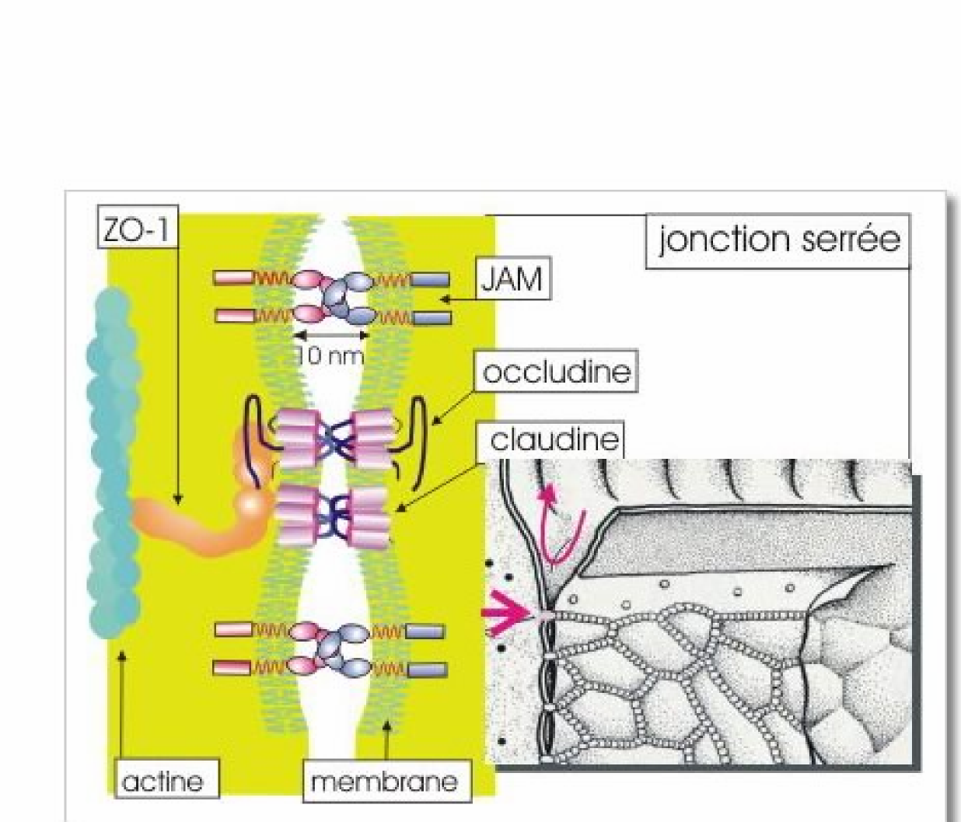
1- "Tight" watertight junctions or
zonula-occludens
- Tight joints leave no gaps between two membranes => they serve as a seal to prevent the exchange of material through the membrane. - The tight junctions between adjacent cells form a continuous belt around the edge of an organ or body cavity. - Particularly important for intestinal epithelial cells, gland ducts and cavities and the bladder as well as endothelial cells, they prevent fluids from infiltrating outside, between cells.

Slide 19
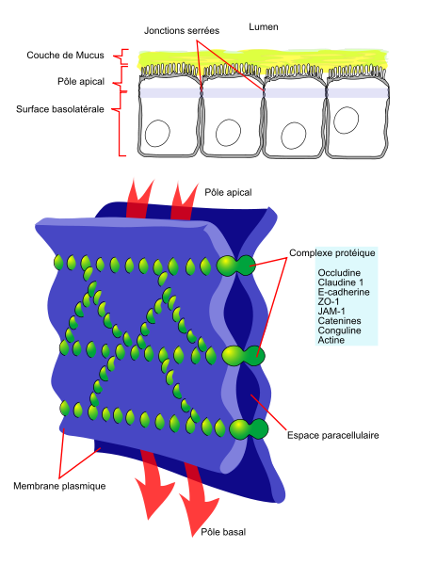

Slide 20
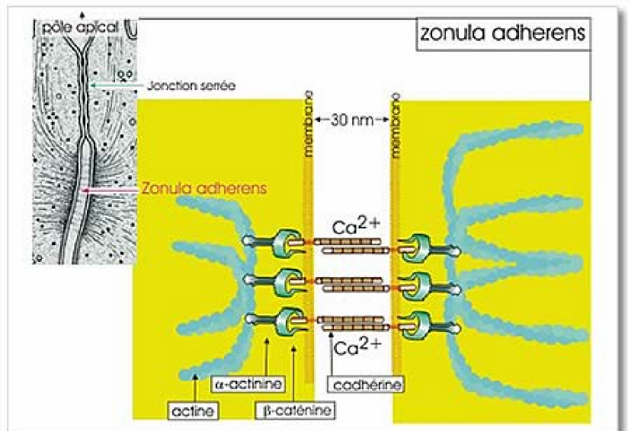
2- The "adhesive" anchorage junctions or zonula-adherens
Organization of the junction:
Adhesion molecules : cadherins
Ca²⁺-dependent, homophil interactions Intracytoplasmic domains are linked to cytoskeleton associated proteins: catenins connected to actin microfilaments

Slide 21
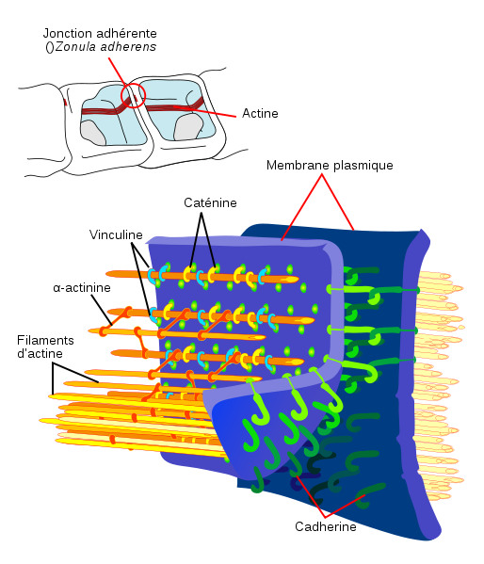

Slide 22
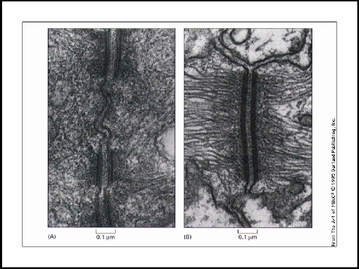
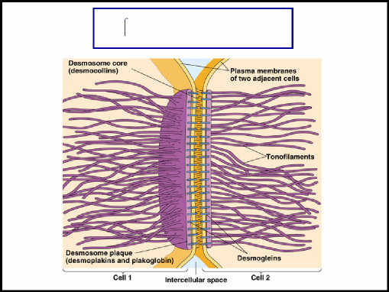
3- Desmosome Adhesion molecules: these are cadherins⇒desmocollines and desmoglein (transmembrane protein) Desmoplakin (dense plate molecules): associated with intermediate keratin filaments (epithelial cells) There are two molecules that act as intermediates between the transmembrane molecules (desmocolline and desmoglein), and the dense plate molecules (desmoplakin) ⇒ plakoglobin and plakophilin

Slide 23
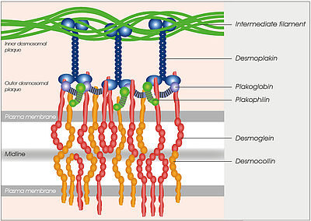
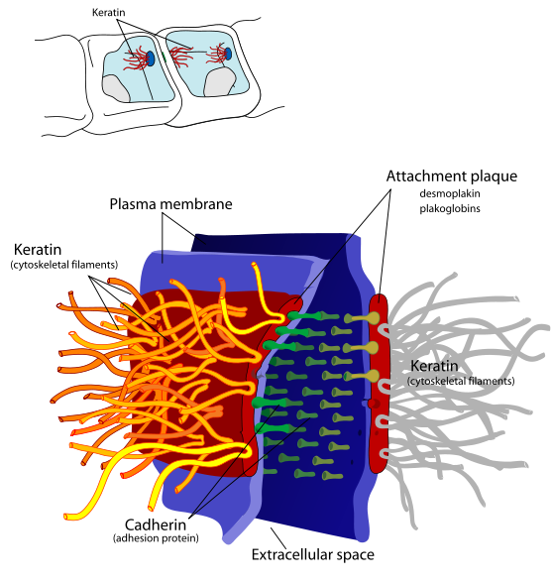

Slide 24
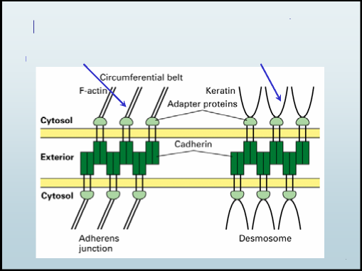
Two types of cadherin junction
Actin microfilaments Keratin intermediate filaments

Slide 25
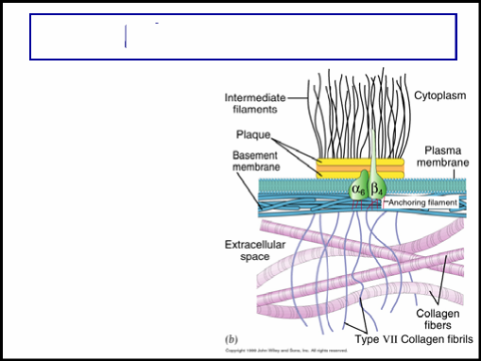
4 - The Hemidesmosome
Located at the basal pole of the epithelia, they attach the epithelium to the basal lamina; by interaction between the integrins of the hemidesmosomes and the laminins of the basal lamina. "plaque" Plectin: it is a structural protein that binds cell membranes to intermediate cytokeratin filaments

Slide 26
5 - Gap junctions (nexus) – Allow direct communication between the cytoplasms of adjacent cells – Exist in most tissues of the body: epithelia, osteocytes, myocardial cells, smooth muscle cells, nervous system – Passage of chemical or electrical signals between cells – Small molecule exchanges or ion passages Passage of ions and therefore of an electric current from one cell to another. Molecules up to 1500 daltons, ions: Na+, K+, Ca²⁺, CI. Exchange of cAMP and metabolite. Security: Shutting down when cytosolic [Ca] increases.

Slide 27
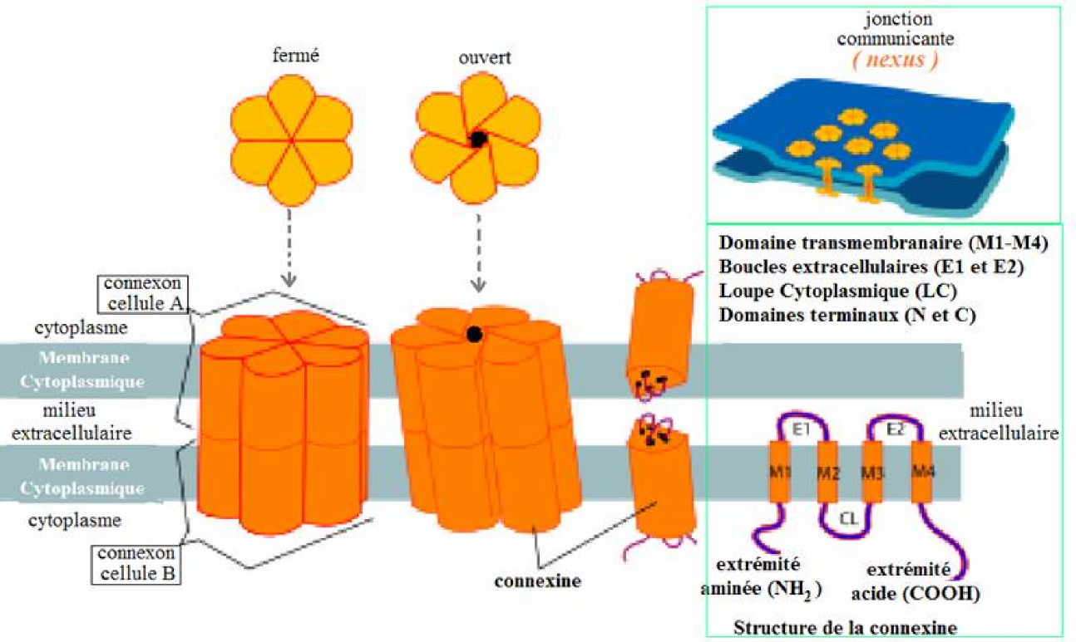

Slide 28
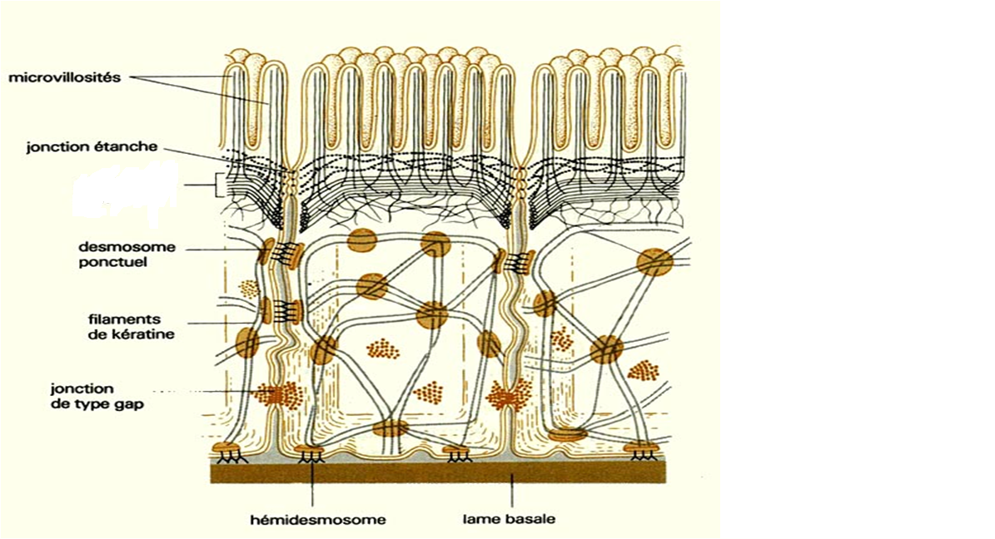
jonction d’ancrage

